Slide 1
Introduction to SAS proc sql
Leah Durbak
July 10, 2019

Slide 2
Setup
Start SAS
SAS Studio - https://uint.urban.org/sasusers/index.html#sas-studio
Get session materials from Git
https://github.com/UI-Research/AdvancedSAS
Click on “intro_to_procsql_20190710.sas”
Click on “raw” button in top right of code block
Copy and paste the SAS code into your SAS environment
Other materials:
This PowerPoint
SQL syntax handout

Slide 3
Objectives
To give an overview of why you may want to use proc sql in your SAS code
Provide an introduction to SQL syntax within SAS
Demonstrate proc sql queries
Briefly discuss joins in proc sql
List resources where you can learn more

Slide 4
Why use proc sql?
Query data with fewer and shorter statements more efficiently
Quickly retrieve, update, and report on info in SAS data sets
Access other databases
Only way to join a SAS table and an Oracle table, can be useful with other RDMS
Easier joins*
No sorting needed! Can join on different variable names!
Increased flexibility in your SAS code
Data/proc steps vs. proc sql
*mostly
Notes:
The primary reason to use proc sql is that it can usually query your data with fewer and shorter statements than traditional SAS code. It also often uses fewer resources than other data or proc steps, so it will run more efficiently
SQL syntax learned for proc sql is transferable to other SQL packages, and sometimes it is the only way to access other databases, like if you want to join a SAS table and an Oracle table
Another big benefit is the join functionality of proc sql requires can be easier to use
Some tasks are easier to complete in “traditional” proc or data steps, but some things are easier to complete using proc sql. Adding proc sql to your SAS toolkit will increase your flexibility and efficiency in your SAS code

Slide 5
What is SQL?
Structured Query Language
SQL has been around since ~1970s
Despite being largely standardized, different implementations exist
SAS proc sql follows* American National Standards Institute (ANSI) guidelines
SAS has extended some SAS functionality into proc sql
Non-procedural
Informs the DBMS what data are needed, not where or how to access it
*mostly
Notes:
SQL is an acronym for Structured Query Language
It’s been around since the 1970s and is a database programming language for querying and updating information stored in databases
Even those it is largely standardized, there are different implementations of SQL. So you may hear people talking about Redshift SQL or PostgreSQL for example
SAS generally follows the American National Standards Institute or ANSI guidelines
So that means that the syntax within a proc sql statement are different than traditional SAS syntax
And I say proc sql generally follows ANSI standards because SAS has extended some SAS functions to work within SQL, like variance function and keep/drop statements, that would not work within the standard ANSI SQL language
SQL is what is called a non-procedural language. So this means it tells the database manage what you want out of the database, but it lets SQL decide where and how to access the data

Slide 6
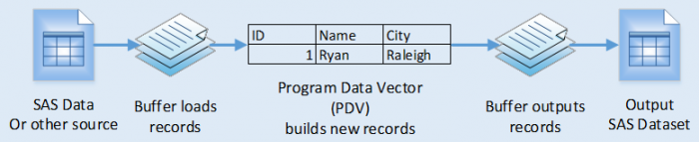
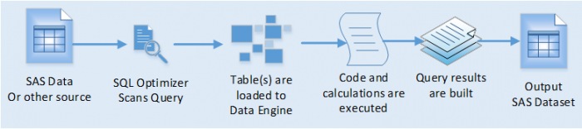
System resources & proc sql
SAS data step:
Sequential process
Brings in and outputs a single record at a time
SAS proc sql:
Simultaneous process
All-to-all
Temporary tables are placed in memory to build results
Images from: https://www.zencos.com/blog/sas-sql-vs-data-step-performance/
Notes:
As a high level overview of the processing differences between a SAS data step and proc sql
It is important to know that a data step is a sequential process
The process brings in one record at a time, performs calculations, and then outputs one at a time
In proc sql, processes happens simultaneously
For example, when you do a join in proc sql, it performs an all-to-all match
This type of processing requires temporary tables to be stored in memory, which can take up a lot of memory
You specific system resources are going to limit how big is too big for proc sql to handle
If you are accessing data in a database, like a Hive database, proc sql is probably going to be fine
On the SAS1 server, I can use proc sql on a dataset of 77 million records in a reasonable amount of time
We will be posting guidance about size limits on SAS1 on the SAS Users Group website when we have them
The other interesting thing about the extensions that SAS has implement with proc sql
So generally when you call a proc sql with only ANSI SQL statements, SAS will pass the query on to the SQL Optimizer and those tasks will be completed on the database/SQL side
However, if you call a SAS function in a proc sql statement, like var for variance, SAS will have to bring the query into memory first and then perform the function because SQL won’t know how to do it
So it is important to be thoughtful about when proc sql will have to bring the data back to SAS when you are using proc sql if your data is large

Slide 7
Syntax and basic queries

Slide 8

proc sql syntax and working data
sashelp.class data
proc sql options;
create table table-name as
select column(s)
from table-name
where expression
group by column(s)
having expression
order by column(s);
quit;
Obs | Name | Sex | Age | Height | Weight
1 | Alfred | M | 14 | 69.0 | 112.5
2 | Alice | F | 13 | 56.5 | 84.0
3 | Barbara | F | 13 | 65.3 | 98.0
4 | Carol | F | 14 | 62.8 | 102.5
5 | Henry | M | 14 | 63.5 | 102.5
6 | James | M | 12 | 57.3 | 83.0
7 | Jane | F | 12 | 59.8 | 84.5
8 | Janet | F | 15 | 62.5 | 112.5
9 | Jeffrey | M | 13 | 62.5 | 84.0
10 | John | M | 12 | 59.0 | 99.5
11 | Joyce | F | 11 | 51.3 | 50.5
12 | Judy | F | 14 | 64.3 | 90.0
13 | Louise | F | 12 | 56.3 | 77.0
14 | Mary | F | 15 | 66.5 | 112.0
15 | Philip | M | 16 | 72.0 | 150.0
16 | Robert | M | 12 | 64.8 | 128.0
Notes:
This is the basic proc sql syntax structure. Order is important here, so if a quick trouble-shooting tip if a query is not running as expected is to check that these statements are in the correct order. We’ll walk through these statements at least briefly, focusing on the most useful ones for when you are first learning proc sql.
Proc sql statements always begin with a proc sql statement and end with a quit statement, both followed by a semi colon.
Between the proc sql and the quit, you can put as many sql statements as you want, each ending with a semi colon.
The sql statement will run as soon as it encounters a semi colon. End is meaningless to proc sql
Within the proc sql statement, the clauses you include will define how the data will be returned
No semi-colons between clauses – only at the end of the sql statement
The underlined clauses are the only required clauses. So we’ll first take a look at the select column from table clauses, and work up to what the other clauses do
Be prepared to use a lot more commas than traditional SAS syntax
We’re mostly going to be using a data set that is include with SAS in the sashelp library classed class, which you can see a sample of here

Slide 9
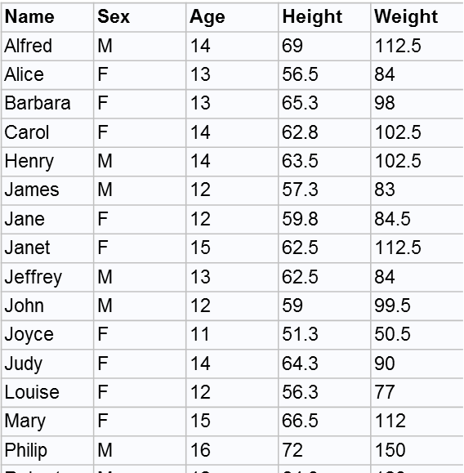
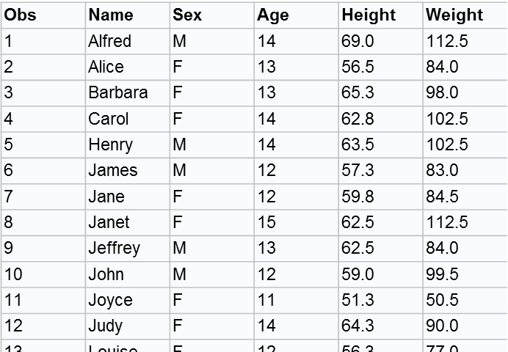
Simple queries in proc sql
proc sql;
select *
from sashelp.class;
quit;
proc print data=sashelp.class;
run;
Only one ; per sql statement
Notes:
These are examples of basically the most basic queries you can build using proc sql.
Let’s talk about the first example on the left side. The select statement followed by an asterisk selects all columns from the data set, which is the sashelp.class here
Proc print is the equivalent process here

Slide 10
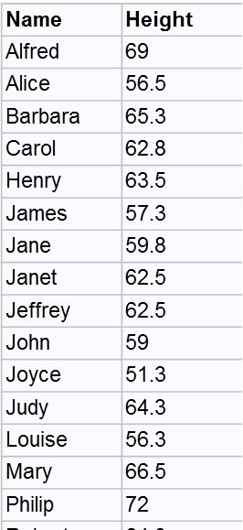
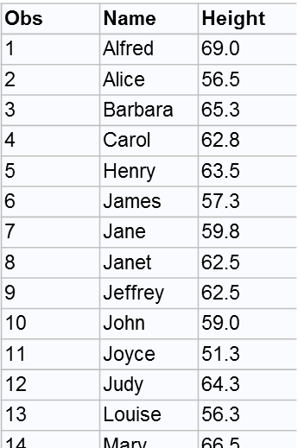
Simple Queries in proc sql
proc sql;
select Name, Height
from sashelp.class;
quit;
proc print data=sashelp.class;
var Name Height;
run;
Commas separate variables
Notes:
You can limit the results of a proc sql query to select variables by naming them in the select statement instead of using an asterisk, which I did here with the Name and Height variables (note the separation with a comma!)
The equivalent proc print code would be to using a var statement in the proc print step

Slide 11
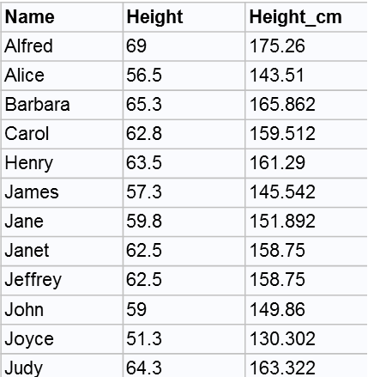
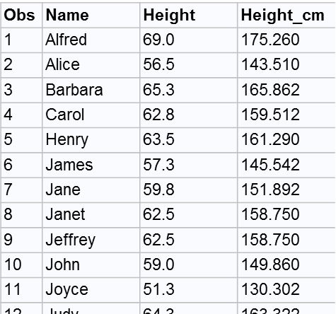
Create new variables
proc sql;
select Name, Height,
(Height*2.54) as Height_cm
from sashelp.class;
quit;
data class;
set sashelp.class;
Height_cm = Height*2.54;
run;
proc print data=class;
run;
NOTE: There were 19 observations read from the data set SASHELP.CLASS.
NOTE: The data set WORK.CLASS has 19 observations and 3 variables.
NOTE: DATA statement used (Total process time):
real time 0.00 seconds
cpu time 0.00 seconds
NOTE: There were 19 observations read from the data set WORK.CLASS.
NOTE: PROCEDURE PRINT used (Total process time):
real time 0.06 seconds
cpu time 0.00 seconds
Notes:
Variables can be created dynamically in proc sql, as you can see here. Height_cm is created by multiplying the Height variable by 2.54 and specifying the variable name as Height_cm.
This example show proc sql can create a new variable and return the results in a single step
The equivalent step outside of proc sql would be to use a data step to create the Height_cm variable and proc print to view the results

Slide 12
A word on timing
12 proc sql;
13 select Name, Height, (Height*2.54) as Height_cm
14 from sashelp.class;
15 quit;
NOTE: PROCEDURE SQL used (Total process time):
real time 0.11 seconds
cpu time 0.03 seconds
16 /*equiv*/
17 data class;
18 set sashelp.class (keep = Name Height);
19 Height_cm = Height*2.54;
20 run;
NOTE: There were 19 observations read from the data set SASHELP.CLASS.
NOTE: The data set WORK.CLASS has 19 observations and 3 variables.
NOTE: DATA statement used (Total process time):
real time 0.05 seconds
cpu time 0.03 seconds
21 proc print data=class;
22 run;
NOTE: There were 19 observations read from the data set WORK.CLASS.
NOTE: PROCEDURE PRINT used (Total process time):
real time 0.08 seconds
cpu time 0.03 second
Notes:
Proc sql can generally produce results in either less or equivalent time to traditional SAS statements
However, the real time saving comes into play when you can combine something you’d have to do in multiple DATA and PROC steps into one PROC SQL step
So here you can see it took proc sql .11 seconds to print out the Name, Height and calculated Height_cm columns
Whereas this took a DATA step and a PROC step without proc sql, which took .05 seconds and .08 seconds respectively

Slide 13
Create new tables
proc sql outobs=5;
create table work.heightcm_meanage_sql as
select Name, (Height*2.54) as Height_cm, mean(Age) as mean_Age
from sashelp.class;.
select *
from heightcm_meanage_sql;
quit;
proc means data=sashelp.class;
var Age;
output out = class_stats mean = mean_Age;
run;
data heightcm_meanage (keep = Name Height_cm mean_Age);
if _n_ = 1 then set class_stats (keep = mean_Age);
set sashelp.class;
Height_cm = Height*2.54;
run;
proc print data=heightcm_meanage (obs=5);
run;
Name | Height_cm | mean_Age
Alfred | 175.26 | 13.31579
Alice | 143.51 | 13.31579
Barbara | 165.862 | 13.31579
Carol | 159.512 | 13.31579
Henry | 161.29 | 13.31579
Obs | mean_Age | Name | Height_cm
1 | 13.3158 | Alfred | 175.260
2 | 13.3158 | Alice | 143.510
3 | 13.3158 | Barbara | 165.862
4 | 13.3158 | Carol | 159.512
5 | 13.3158 | Henry | 161.290
Notes:
If you want to “save” your query, you can use the create table [table name] as syntax before the select statement.
In this query, we’re creating the new table new_table_sql with all the variables from the sashelp.class table, and adding the variable Height_cm as well as mean_Age
Then we’re outputting the results of the new_table_sql with the next select * statement
One option you can include in the proc sql statement is the outobs option, which limits the output to whatever number of records your specify. There is also a corresponding inobs option, which is useful if you want to limit the number of observations that proc sql takes as input from your data source
The equivalent process without proc sql is a little more complicated:
First, you need to get the mean_Age variable using a proc means
Next, create the new table, which we’re call new_table_data, with a data step
Then you can add it to the new table using a if _n_ the set statement
Then you add in the rest of the desired data using set sashelp.class
Then create the Height_cm variable
Then using proc print with obs = 5 to output the equivalent data as the proc sql statements

Slide 14
Filter data using where
proc sql;
select Name, Sex, Age
from sashelp.class
where Height > 60;
quit;
proc print data=sashelp.class;
var Name Sex Age;
where Height > 60;
run;
Name | Sex | Age
Alfred | M | 14
Barbara | F | 13
Carol | F | 14
Henry | M | 14
Janet | F | 15
Jeffrey | M | 13
Judy | F | 14
Mary | F | 15
Philip | M | 16
Robert | M | 12
Ronald | M | 15
William | M | 15
Obs | Name | Sex | Age
1 | Alfred | M | 14
3 | Barbara | F | 13
4 | Carol | F | 14
5 | Henry | M | 14
8 | Janet | F | 15
9 | Jeffrey | M | 13
12 | Judy | F | 14
14 | Mary | F | 15
15 | Philip | M | 16
16 | Robert | M | 12
17 | Ronald | M | 15
19 | William | M | 15
Notes:
You can quickly filter data using a where statement
The example on the left shows that you do not need to include the filtered variable in the query output
An equivalent process can be performed with proc print by specifying variables in the var statement and a where statement

Slide 15
Filter data using where
proc sql;
select *, (Height*2.54) as Height_cm
from sashelp.class
where (Height*2.54) <= 155;
quit;
data filter;
set sashelp.class;
Height_cm = Height*2.54;
run;
proc print data=filter;
var Name Sex Age Height_cm;
where Height_cm <= 155;
run;
Name | Sex | Age | Height | Weight | Height_cm
Alice | F | 13 | 56.5 | 84 | 143.51
James | M | 12 | 57.3 | 83 | 145.542
Jane | F | 12 | 59.8 | 84.5 | 151.892
John | M | 12 | 59 | 99.5 | 149.86
Joyce | F | 11 | 51.3 | 50.5 | 130.302
Louise | F | 12 | 56.3 | 77 | 143.002
Thomas | M | 11 | 57.5 | 85 | 146.05
Obs | Name | Sex | Age | Height_cm
2 | Alice | F | 13 | 143.510
6 | James | M | 12 | 145.542
7 | Jane | F | 12 | 151.892
10 | John | M | 12 | 149.860
11 | Joyce | F | 11 | 130.302
13 | Louise | F | 12 | 143.002
18 | Thomas | M | 11 | 146.050
Notes:
The example in the middle shows how you must use the where statement with calculated variables. SQL cannot reference a newly calculated variable within a where statement, so if you need to filter on that variable, you must include the calculation in the where statement
If you want to do this process without proc sql, you can create a new data set and a the Height_cm variable in a data step
Then use proc print to filter the data with a where statement and limit the output variables using a var statement

Slide 16
Filter data using where
proc sql;
select Name, (Height*2.54) as Height_cm
from sashelp.class
where Name in ('Alice','James') or Age > 14;
quit;
data filter;
set sashelp.class;
Height_cm = Height*2.54;
run;
proc print data=filter;
var Name Height_cm;
where Name in ('Alice','James') or Age > 14;
run;
Name | Age | Height_cm
Alice | 13 | 143.51
James | 12 | 145.542
Janet | 15 | 158.75
Mary | 15 | 168.91
Philip | 16 | 182.88
Ronald | 15 | 170.18
William | 15 | 168.91
Obs | Name | Age | Height_cm
2 | Alice | 13 | 143.510
6 | James | 12 | 145.542
8 | Janet | 15 | 158.750
14 | Mary | 15 | 168.910
15 | Philip | 16 | 182.880
17 | Ronald | 15 | 170.180
19 | William | 15 | 168.910
Notes:
Using where to filter on multiple conditions is pretty similar to what you need to do outside of proc sql
Again the utility of using proc sql is that you can perform the calculation and output the results in a single step
Whereas if you don’t use proc sql, you need to perform the Height_cm calculation in a data step and the output the results using a proc print statement

Slide 17
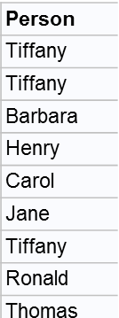

Filter data using where
roster
proc sql;
select *
from sashelp.class
where Name in
(select distinct Person
from roster);
quit;
output
Name | Sex | Age | Height | Weight
Barbara | F | 13 | 65.3 | 98
Carol | F | 14 | 62.8 | 102.5
Henry | M | 14 | 63.5 | 102.5
Jane | F | 12 | 59.8 | 84.5
Ronald | M | 15 | 67 | 133
Thomas | M | 11 | 57.5 | 85
William | M | 15 | 66.5 | 112
data sashelp_class ;
set sashelp.class;
run;
proc sort data=sashelp_class (rename=(Name=Person));
by Person;
run;
proc sort data=roster nodupkey;
by Person;
run;
data merge_subquery;
merge sashelp_class (in=insashelpclass) roster(in=inroster);
by Person;
if insashelpclass and inroster;
run;
proc print data=merge_subquery;run;
Notes:
The where statement can also handle subqueries
Say we want to pull observations for which the individual’s name appeared in the table roster, which is unsorted and contains duplicates
In the where subquery, we tell sql to look for distinct observations within roster (which contains names in the Person variable) and return the observations from sashelp.class that have matches in the roster table
To do this without proc sql, you need to:
Sort both data sets
Remove duplicates from the roster (nodupkey)
Merge the two data sets with an if statement to indicate you only want the matches from the sashelp.class data to return
Print the results with a proc print

Slide 18
WHERE limits what is data is brought in
proc sql options;
create table table-name as
select column(s)
from table-name
where expression
group by column(s)
having expression
order by column(s);
quit;
These statements tell SQL what data to bring back*
These statements tell SQL what to do with the data once it is brought in
*Unless you use a SAS-extended function in proc sql
Notes:
If you are working with big data, it is important to note that the select, from, and where statements limit the data that SQL brings back
The statements below the where clause are performed AFTER the data is filtered
So if you can limit with a where clause, that can be helpful when performing calculations on big data

Slide 19
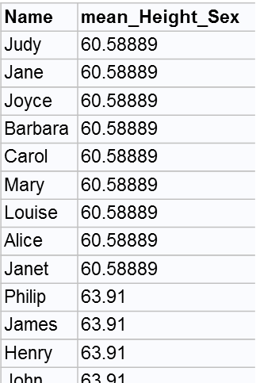
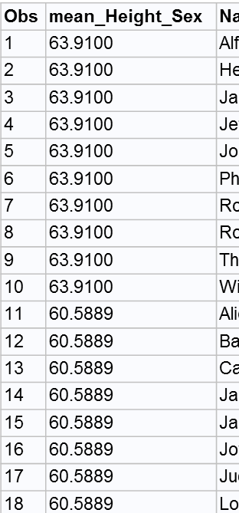
Summarizing data using group by
proc sql;
select *, mean(Height) as mean_Height_Sex
from sashelp.class
group by Sex;
quit;
proc means data=sashelp.class mean noprint;
class Sex;
var Height;
output out = height_mean (drop = _TYPE_ _FREQ_) mean=mean_Height;
run;
data mean_by_Sex_f;
if _n_ = 1 then set height_mean (keep = Sex mean_Height);
where Sex = 'F';
set class;
where Sex = 'F';
run;
data mean_by_Sex_m;
if _n_ = 1 then set height_mean
(keep = Sex mean_Height);
where Sex = 'M';
set class;
where Sex = 'M';
run;
data mean_height_by_sex
(keep = Name mean_Height_Sex);
set mean_by_Sex_m
(rename=(mean_Height = mean_Height_Sex))
mean_By_Sex_f
(rename=(mean_Height = mean_Height_Sex));
run;
proc print data=mean_height_by_sex;
run;
Notes:
The group by clause defines how the data will be grouped when you use an aggregation function in the select clause
The first example in the left shows the mean Height grouped by Sex
If you want to get an equivalent output table without proc sql, it takes many more steps:
Here I decided to divide up the data into two different tables, one with males and one with females
Then I used proc means on both those data sets
Then I used the if _n_ =1 then set to apply the Sex-specific mean Height to the respective data set
Then I joined the male and female data sets together
Then I printed the results using proc print

Slide 20
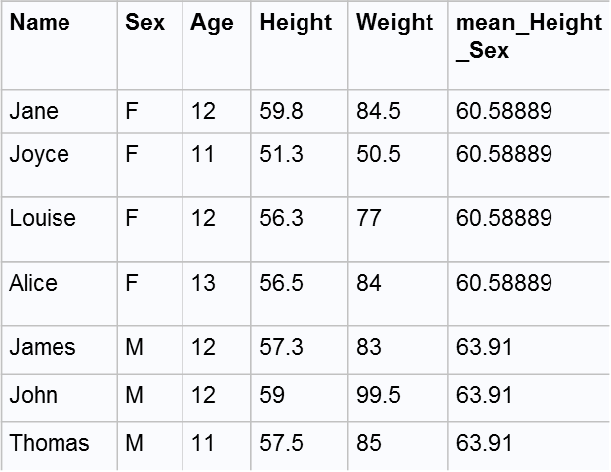
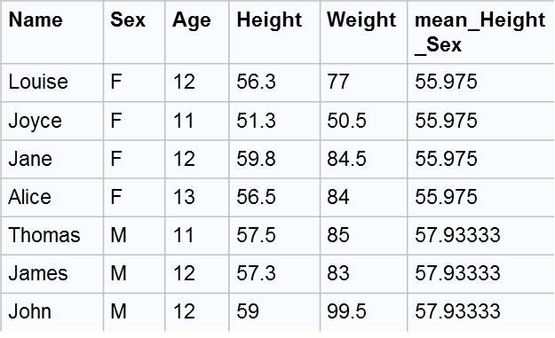
Summarizing data using group by
proc sql;
select *, mean(Height) as mean_Height_Sex
from sashelp.class
group by Sex
having Height < 61;
quit;
proc sql;
select *, mean(Height) as mean_Height_Sex
from sashelp.class
where Height < 61
group by Sex;
quit;
Notes:
The having clause can be used under the group by statement to limit the output data. But note that this does not change the overall calculation – just the output results
Because there is no WHERE statement, all of the data is brought into this calculation
Having just limits what data is printed

Slide 21
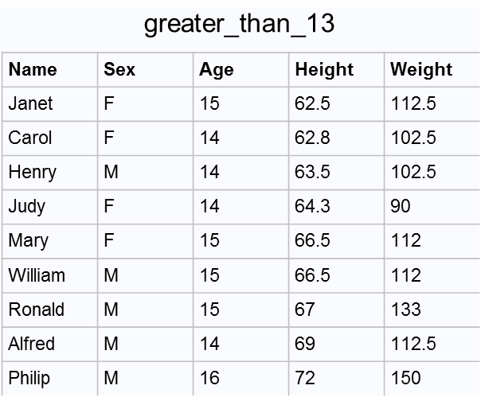
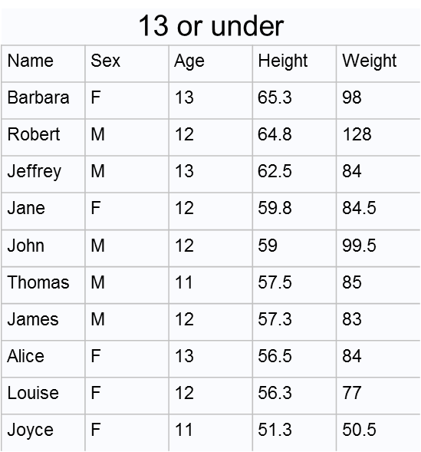
Order by
proc sort sashelp.class out=class_to_sort;
by Height;
where Age > 13;
run;
proc print data= class_to_sort;
title "greater than 13";
run;
proc sql;
title greater_than_13;
select *
from sashelp.class
where Age > 13
order by Height;
title 13 or under;
select *
from sashelp.class
where Age <= 13
order by Height desc;
quit;
Titles are not in “ ”
proc sort sashelp.class out=class_to_sort_desc;
by descending Height;
where Age <= 13;
run;
proc print data=class_to_sort_desc;
title "13 or under";
run;
Notes:
Order by sorts the SQL result by the specified variable.
The default order is ascending order and you can change this to descending by all desc to the order by statement
Again, the order of the where and order by statements is important. If you put an order by before a where statement, you will get a syntax error
Note that titles in proc sql are just a little different than traditional SAS titles. There are no apostrophes needed
Also note that you can perform more than one sql query under a single proc sql statement.
I produced both of these tables in a single proc sql statement by ending the first sql startment with a semi-colon, followed by the next statement and then ending with quit.
The non-sql equivalent to these two queries is to create a new data set (because you can’t sort the data sets included with SAS), use proc sort to sort the data by the desired variable and order, and then using proc print to display the data

Slide 22
More complex query in proc sql
proc sql;
select count(Name) as num_Obs,
count(distinct Name) as unique_Obs,
mean(Age),
median(Height) as median_Height,
std(Weight) AS stdev_Weight,
(select count(distinct Name)
from sashelp.class
where Sex = "F") as num_Female
from sashelp.class;
quit;
Naming new variables with as var_name is optional
num_Obs | unique_Obs |  | median_Height | stdev_Weight | num_Female
19 | 19 | 13.31579 | 62.8 | 22.77393 | 9
Notes:
This is an example of a more complex query that you can achieve with what we’ve discussed so far
The output of this query is just dynamically created aggregate results:
The first is the count function – this returns the number of non-missing observations of a certain variable
Next is the count distinct returns the number of non-missing unique values of a certain variable
Next there is the mean function, which we’ve seen previously
Next is the median and standard deviation functions, which are self-explanatory
Finally, we have a subquery
A subquery is a query nested within a query, contained within parentheses
Usually used where or having statements
You can access other tables within a subquery
This subquery is returning the number of unique names from the subset of the table where Sex = F

Slide 23
Joins in proc sql

Slide 24
Merge vs. proc sql Joins
sashelp.class
score
Name | Sex | Age | Height | Weight
Alfred | M | 14 | 69 | 112.5
Alice | F | 13 | 56.5 | 84
Barbara | F | 13 | 65.3 | 98
Carol | F | 14 | 62.8 | 102.5
Henry | M | 14 | 63.5 | 102.5
James | M | 12 | 57.3 | 83
Jane | F | 12 | 59.8 | 84.5
Janet | F | 15 | 62.5 | 112.5
Jeffrey | M | 13 | 62.5 | 84
John | M | 12 | 59 | 99.5
Joyce | F | 11 | 51.3 | 50.5
Judy | F | 14 | 64.3 | 90
Louise | F | 12 | 56.3 | 77
Mary | F | 15 | 66.5 | 112
Philip | M | 16 | 72 | 150
Robert | M | 12 | 64.8 | 128
Ronald | M | 15 | 67 | 133
Thomas | M | 11 | 57.5 | 85
William | M | 15 | 66.5 | 112
Person | Score
Alfred | 85
Alice | 80
Barbara | 95
Carol | 50
Henry | 90
James | 75
Jane | 60
Janet | 70
Jeffrey | 60
John | 45
Joyce | 90
Judy | 75
Louise | 95
Robert | 65
Ronald | 95
Thomas | 85
Tiffany | 85
William | 70
Notes:
To review, a merge without sql can only occur with sorted data (using proc sort) and merge on variables of the same name.
So we’re going to look at merges and joins using the sashelp.class and this class_score table that I made up
We’re going to match these two tables on the variable Name in the sashelp.class table and Person in class_score table
There are some observations in both tables without matches in the other

Slide 25
Inner join
Table A
Table B
proc sql;
select a.Name, a.Age, b.Score
from sashelp.class as a inner join class_score as b
on a.Name = b.Person;
quit;
Name | Age | Score
Alfred | 14 | 85
Alice | 13 | 80
Barbara | 13 | 95
Carol | 14 | 50
Henry | 14 | 90
James | 12 | 75
Jane | 12 | 60
Janet | 15 | 70
Jeffrey | 13 | 60
John | 12 | 45
Joyce | 11 | 90
Judy | 14 | 75
Louise | 12 | 95
Robert | 12 | 65
Ronald | 15 | 95
Thomas | 11 | 85
William | 15 | 70
data inner_join (keep = Name Age Score);
merge sashelp_class (in=insashelp) score_sorted (in = inclassscore);
by Name;
if insashelp and inclassscore;
run;
proc print data=inner_join;
run;
Notes:
The most simple joins in proc sql are inner joins
In the select clause, you identify the columns you want to carry through. Here, we’re returning all the columns from Table A (as specified by the asterisk), and the Score column from Table B
In the from clause, you specify the two tables you want to join. You can give the tables you are joining aliases, like I did here as A or B (or whatever you want to call them), but I find that it provides more clarity to your code so I recommend it
You identify the matching variable in the where statement and the output returned is the intersection of the two tables
Observations that don’t have matches are dropped
The equivalent code without proc sql (not shown here) uses an if table A and table B
If you’re getting confused about which join type you want to use, googling sql joins will bring up these types of useful Venn diagrams to help you visualize which process you should use while you are familiarizing yourself with the join types.

Slide 26
Why are these equivalent?
proc sql;
select a.Name, a.Age, b.Score
from sashelp.class as a inner join class_score as b
on a.Name = b.Person;
quit;
proc sql;
select a.Name, a.Age, b.Score
from sashelp.class as a, class_score as b
where a.Name = b.Person;
quit;
Notes:
Because the where clause limits the data that can come back, only observations with matching a.Name and b.Person will come back

Slide 27
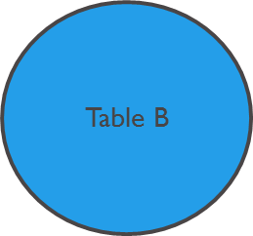
Outer Join - Full
Name | Age | Person | Score
Alfred | 14 | Alfred | 85
Alice | 13 | Alice | 80
Barbara | 13 | Barbara | 95
Carol | 14 | Carol | 50
Henry | 14 | Henry | 90
James | 12 | James | 75
Jane | 12 | Jane | 60
Janet | 15 | Janet | 70
Jeffrey | 13 | Jeffrey | 60
John | 12 | John | 45
Joyce | 11 | Joyce | 90
Judy | 14 | Judy | 75
Louise | 12 | Louise | 95
Mary | 15 |  | .
Philip | 16 |  | .
Robert | 12 | Robert | 65
Ronald | 15 | Ronald | 95
Thomas | 11 | Thomas | 85
 | . | Tiffany | 85
William | 15 | William | 70
proc sql;
select a.Name, a.Age, b.*
from sashelp.class as a full join score as b
on a.Name = b.Person;
quit;
Table A
Table B
Notes:
In proc sql, there are also three out joins
Here, we can see that no sorting is necessary and you can match on variables with different names.
Because we are joining on variables with different names, you can see that Name and Person variables are maintained in the results. This may or may not be desirable based on your data.

Slide 28
Merge
proc sort data=sashelp_class out=sashelp_class;
by Name;
run;
proc sort data=score (rename=(Person=Name))
out = score_sorted;
by Name;
run;
data full_outer_merge (keep = Name Age Score);
merge sashelp_class score_sorted;
by Name;
run;
proc print data=full_outer_merge;
run;
Obs | Name | Age | Score
1 | Alfred | 14 | 85
2 | Alice | 13 | 80
3 | Barbara | 13 | 95
4 | Carol | 14 | 50
5 | Henry | 14 | 90
6 | James | 12 | 75
7 | Jane | 12 | 60
8 | Janet | 15 | 70
9 | Jeffrey | 13 | 60
10 | John | 12 | 45
11 | Joyce | 11 | 90
12 | Judy | 14 | 75
13 | Louise | 12 | 95
14 | Mary | 15 | .
15 | Philip | 16 | .
16 | Robert | 12 | 65
17 | Ronald | 15 | 95
18 | Thomas | 11 | 85
19 | Tiffany | . | 85
20 | William | 15 | 70
Table A
Table B
Notes:
The equivalent process in without proc sql is a merge
To review, a merge without sql can only occur with sorted data (using proc sort) and merge on variables of the same name.
So we had to sort both data sets first
And rename ‘Person’ to ‘Name in the class_score table
The results of this merge include all observations in table A and table B, so some of the observations have missing values where they did not have a match in the other table

Slide 29
Outer Join - Left
Table A
Table B
proc sql;
select a.*,b.Score
from sashelp.class a left join score b
on a.Name = b.Person;
quit;
Obs | Name | Age | Score
1 | Alfred | 14 | 85
2 | Alice | 13 | 80
3 | Barbara | 13 | 95
4 | Carol | 14 | 50
5 | Henry | 14 | 90
6 | James | 12 | 75
7 | Jane | 12 | 60
8 | Janet | 15 | 70
9 | Jeffrey | 13 | 60
10 | John | 12 | 45
11 | Joyce | 11 | 90
12 | Judy | 14 | 75
13 | Louise | 12 | 95
14 | Mary | 15 | .
15 | Philip | 16 | .
16 | Robert | 12 | 65
17 | Ronald | 15 | 95
18 | Thomas | 11 | 85
19 | William | 15 | 70
After sorting/renaming
data left_merge (keep = Name Age Score);
merge sashelp_class (in=insashelp) score_sorted (in = inclassscore);
by Name;
if insashelp;
run;
proc print data=left_merge;
run;
Notes:
The other two types of outer joins in proc sql are left and right joins
Left and right refer to the position of the table in regards to the left join statement in the from clause
So in this example, we’re left joining all the columns from table A to the Score column in table B on Name = Person.
This means that all the observations from table A will be included in the output, even if there is not a corresponding match in table B, which is the case with Mary and Philip in the output
The non-sql equivalent is a merge with an if statement that indicates the left-hand table.

Slide 30
Outer Join - Right
Table A
Table B
proc sql;
select a.Name, a.Age, b.*
from sashelp.class a right join score b
on a.Name = b.Person;
quit;
Name | Age | Person | Score
Alfred | 14 | Alfred | 85
Alice | 13 | Alice | 80
Barbara | 13 | Barbara | 95
Carol | 14 | Carol | 50
Henry | 14 | Henry | 90
James | 12 | James | 75
Jane | 12 | Jane | 60
Janet | 15 | Janet | 70
Jeffrey | 13 | Jeffrey | 60
John | 12 | John | 45
Joyce | 11 | Joyce | 90
Judy | 14 | Judy | 75
Louise | 12 | Louise | 95
Robert | 12 | Robert | 65
Ronald | 15 | Ronald | 95
Thomas | 11 | Thomas | 85
 | . | Tiffany | 85
William | 15 | William | 70
After sorting/renaming
data right_merge;
merge sashelp_class (in=insashelp) score_sorted (in = inclassscore);
by Name;
if inclassscore;
run;
proc print data=right_merge;
run;
Notes:
Similarly, the right join results in all the observations in the table listed to the right of the right join statement – in this case, table B - whether or not it has a match in table A
Here I’ve joined all columns from both table A and table B to show that Tiffany doesn’t have a match in table A.
Again, this can be achieved without proc sql using an if statement (after the data is sorted and renamed)
This results in a near redundancy in the Name and Person columns, which is something that can be addressed with the coalesce function. We’ll be discussing that shortly.

Slide 31
Join multiple tables
proc sql;
select a.Name,a.Age, b.Score, c.Fruit
from sashelp_class a, score b, assign_fruit c
where a.Name = b.Person and
a.Age = c.Age;
quit;
Putting an as in between a table and its alias for a join is optional
Name | Age | Score | Fruit
Alfred | 14 | 85 | Bananas
Alice | 13 | 80 | Oranges
Barbara | 13 | 95 | Oranges
Carol | 14 | 50 | Bananas
Henry | 14 | 90 | Bananas
James | 12 | 75 | Pears
Jane | 12 | 60 | Pears
Janet | 15 | 70 | Kiwis
Jeffrey | 13 | 60 | Oranges
John | 12 | 45 | Pears
Joyce | 11 | 90 | Apples
Judy | 14 | 75 | Bananas
Louise | 12 | 95 | Pears
Robert | 12 | 65 | Pears
Ronald | 15 | 95 | Kiwis
Thomas | 11 | 85 | Apples
William | 15 | 70 | Kiwis
assign_fruit
sashelp_class & score tables
Obs | Age | Group
1 | 11 | Apples
2 | 12 | Pears
3 | 13 | Oranges
4 | 14 | Bananas
5 | 15 | Kiwis
Notes:
In any proc sql join, you can join multiple tables on multiple conditions, as this example shows
Here we’re doing the same inner join from the previous slide, and also adding the assign_fruit table based on age.
Also you can see in this example that the ‘as’ in between a table and the short name you are assigning it is optional

Slide 32
Set Operators

Slide 33
Set Operators
Set operators use the intermediate result sets from two queries to create a final result set
Or…another useful way to join data sets
Set operators: UNION, OUTER UNION, EXCEPT, INTERSECT
Default behavior for rows is modified by adding ALL
Default behavior for columns is modified by adding CORR

Slide 34
UNION
“Which observations are present in both data sets?”
Unique rows from both result sets
In A and/or B tables
UNIQUE rows – duplicates are removed
Unless you add ALL
Aligned by column position in both result sets
Matched by position and data type
Unless the tables being union-ed are exactly the same, you want to add CORR
Notes:
Rows with ALL modifier
Rows from both intermediate result sets are concatenated.
Duplicate rows are not removed from the final result tables.
Columns with CORR modifier
Columns are matched by name and non-matching columns are removed from the intermediate result sets.

Slide 35
Outer Union
“Which observations are present in both or either data sets?”
All rows from both result sets
ALL modifier has no effect
All columns from both result sets
Common columns are not matched
Generally, you want to add CORR to make your output useful
Notes:
Rows
Rows from both intermediate result sets are concatenated.
Duplicate rows are not removed from the final result set.
Columns
All columns from both result sets are selected. Common columns are not overlaid.
Columns with CORR modifier
All columns from both result sets are selected and common columns are overlaid.
Same output as SET with multiple datasets

Slide 36
Except
“Which observations are in A but not in B?”
Unique rows from the first result sets that are not in the second result set
Maintain duplicate rows with ALL
Aligned by column position in both result sets
Matched by position and data type
With CORR, columns are matched by name and non-matching columns are removed
Notes:
Rows
Duplicate rows are removed from the intermediate result sets.
Rows from the first intermediate result set that are not in the second intermediate result set are selected.
Columns
Columns are matched by position and must be the same data type.
Column names in the final result set are determined by the first result set.

Slide 37
Intersect
“Which observations are in both A and B?”
Unique rows from the first result set that are in the second result set
With ALL, duplicate rows will not be removed
Aligned by column position in both result sets
CORR will match by name and non-matching columns will be removed
Notes:
Rows
Duplicate rows are removed from the intermediate result sets.
Rows from the first intermediate result set that are also in the second intermediate result set are selected.
Columns
Columns are matched by position and must be the same data type.
Column names in the final result set are determined by the first result set.

Slide 38
Wrapping Up

Slide 39
Things to consider when writing your code
Familiarity
Can be more efficient to use techniques with which you are most comfortable
Correctness
“All techniques will provide results, but not all results are correct…”
Maintenance
Succinct code < clear/concise/maintainable code
Efficiency of processing resources
All-to-all matching in proc sql may bog down or crash your program
Futures
How will this code be updated? Will it interact with a RDMS?
Adapted from: Dickstein and Pass, “DATA Step vs. PROC SQL: What’s a neophyte to do?”
http://www2.sas.com/proceedings/sugi29/269-29.pdf
Notes:
The decision to use proc sql vs a data or other proc step depends on a number of factors.
It is probably best that the programmer employ those techniques that are most familiar and comfortable
All techniques will provide results, but not all results are correct
Succinct code is often desirable, emphasis should be placed on clear, concise and thus maintainable code
Depending on your system resources and the data you are analyzing, proc sql may not be a good choice
SQL performs all-to-all matching, which means you don’t have to sort your data but it can take up a lot of memory. This can bog down or crash your program depending on your system resources
If the goal of your code is to be moving data or porting code to and from a relational database management system, proc sql is probably going to be a vital component of your code

Slide 40
More of the Advanced SAS Series
Intro to SAS Macros
Automate dynamic code! Reduce typos!
Thursday, July 25, 1-2pm
Same room (Learning and Community Hub, 3030)
Combining SAS Macros and PROC SQL
Even more automation of dynamic code!
Tuesday, August 6th, 12-1pm
Same room (Learning and Community Hub, 3030)
Email ldurbak@urban.org if you don’t have invites!

Slide 41
SAS Users Group Resources
SAS Users Group website
https://uint.urban.org/sasusers/index.html (or search “SAS users group” on the intranet)
Getting started
Bootcamp
Brownbags
Including this one!
UI Guide to SAS
Links to SAS Institute Training
Git Hub

Slide 42
Other useful stuff

Slide 43
Count and Distinct
dist_ages
11
12
13
14
15
16
proc sql;
select count(*) as count_all
from class;
/*get distinct values of a variable*/
select distinct age as dist_ages
from class;
/*get distinct values of a combination of variables*/
select distinct age, Name, Height
from class;
/*count unique records*/
select count(*) as num_unique_recs
from (select distinct * from class);
quit;
count_all
38
Age | Name | Height
11 | Joyce | 51.3
11 | Thomas | 57.5
12 | James | 57.3
12 | Jane | 59.8
12 | John | 59
12 | Louise | 56.3
12 | Robert | 64.8
13 | Alice | 56.5
13 | Barbara | 65.3
13 | Jeffrey | 62.5
14 | Alfred | 69
14 | Carol | 62.8
14 | Henry | 63.5
14 | Judy | 64.3
15 | Janet | 62.5
15 | Mary | 66.5
15 | Ronald | 67
15 | William | 66.5
16 | Philip | 72
num_unique_recs
19

Slide 44
Coalesce
Name | Sex | Age | Height | Weight | x1 | x2 | year_of_birth
Alfred | M | 14 | 69 | 112.5 | . | 2004 | 2004
Alice | F | 13 | 56.5 | 84 | . | . | .
Barbara | F | 13 | 65.3 | 98 | . | . | .
Carol | F | 14 | 62.8 | 102.5 | . | 2004 | 2004
Henry | M | 14 | 63.5 | 102.5 | . | 2004 | 2004
James | M | 12 | 57.3 | 83 | 2006 | . | 2006
Jane | F | 12 | 59.8 | 84.5 | 2006 | . | 2006
Janet | F | 15 | 62.5 | 112.5 | . | 2003 | 2003
Jeffrey | M | 13 | 62.5 | 84 | . | . | .
John | M | 12 | 59 | 99.5 | 2006 | . | 2006
Joyce | F | 11 | 51.3 | 50.5 | 2007 | . | 2007
Judy | F | 14 | 64.3 | 90 | . | 2004 | 2004
Louise | F | 12 | 56.3 | 77 | 2006 | . | 2006
Mary | F | 15 | 66.5 | 112 | . | 2003 | 2003
Philip | M | 16 | 72 | 150 | . | 2002 | 2002
Robert | M | 12 | 64.8 | 128 | 2006 | . | 2006
Ronald | M | 15 | 67 | 133 | . | 2003 | 2003
Thomas | M | 11 | 57.5 | 85 | 2007 | . | 2007
William | M | 15 | 66.5 | 112 | . | 2003 | 2003
proc sql;
select *, coalesce(x1,x2) as
year_of_birth format year4.
from class_birthyear_mixed;
quit;
Format syntax in proc sql shown here
Notes:
The coalesce function handles the problem of selecting the first non-missing value for a set of sparsely populated variables.
In this example we have two columns in the same table, x1 and x2, that have sparsely populated years of birth.
Using coalesce x1, x2 and naming it year_of_birth with a format of year4, we see that year of birth now contains the coalesced year of birth data.
Note that proc sql formats are a little different than traditional SAS format statements.

Slide 45


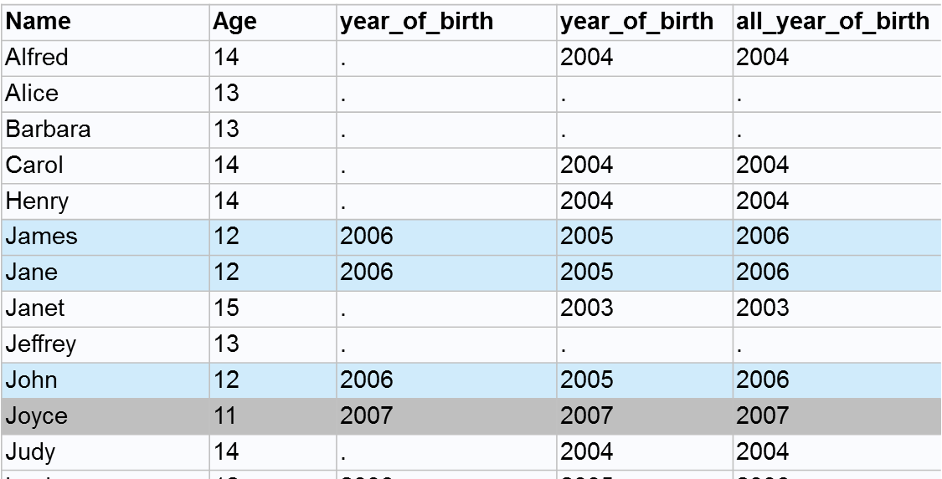
Coalesce
proc sql;
select a.Name, a.Age, a.year_of_birth, b.year_of_birth,
coalesce(a.year_of_birth,b.year_of_birth) as all_year_of_birth format year4.
from class_birthyear_under13 a, class_birthyear_14over b
where a.Name = b.Name;
quit;
Table A
Table B
Notes:
You can also use coalesce when joining tables.
Here we have two data sets, one with years of birth for individuals aged less than 13 and another with years of birth for individuals 14 and over
We can join them on Name and coalesce the two year_of_birth variables to output a single all_year_of_birth variable
Note that I left both table A and table B’s year_of_birth variables in the select statement, but I did not have to
Coalesce will fill in the new variable with the first available non-missing observation. So if you look at the 12 year olds here, you can see Table A has their year of birth as 2006 and Table B has their year of birth as 2005. Coalesce filled in Table A’s value in the new variable, because Table A’s variable is listed first the coalesce function

Slide 46
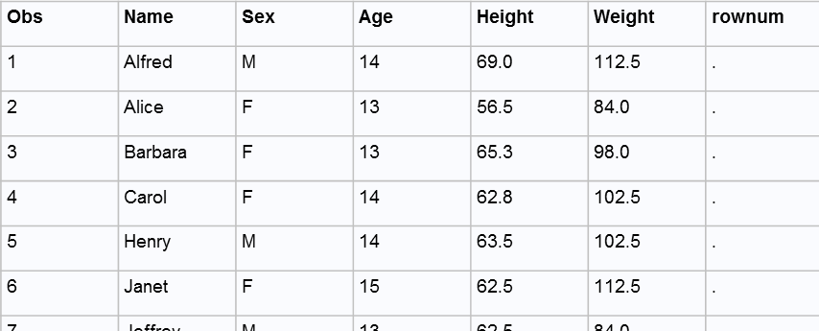
Create table like
monotonic() creates a sequential variable
proc sql;
create table new_class like sashelp.class;
insert into new_class
select *
from sashelp.class
where Age > 12;
alter table new_class
add rownum num;
quit;
proc sql;
update new_class
set rownum = monotonic();
quit;
Obs | Name | Sex | Age | Height | Weight | rownum
1 | Alfred | M | 14 | 69.0 | 112.5 | 1
2 | Alice | F | 13 | 56.5 | 84.0 | 2
3 | Barbara | F | 13 | 65.3 | 98.0 | 3
4 | Carol | F | 14 | 62.8 | 102.5 | 4
5 | Henry | M | 14 | 63.5 | 102.5 | 5
6 | Janet | F | 15 | 62.5 | 112.5 | 6
7 | Jeffrey | M | 13 | 62.5 | 84.0 | 7
8 | Judy | F | 14 | 64.3 | 90.0 | 8
9 | Mary | F | 15 | 66.5 | 112.0 | 9
10 | Philip | M | 16 | 72.0 | 150.0 | 10
11 | Ronald | M | 15 | 67.0 | 133.0 | 11
12 | William | M | 15 | 66.5 | 112.0 | 12
Notes:
Create table like is a useful function because it creates a new, empty table with the attributes of the table indicated after the like.
I’ve used this to create tables that I then populate with results creating in a loop using insert.
In this example, I’m adding data to the new_class table from the sashelp.class table, selecting only those observations with an age greater than 12
You can also add columns using the alter table function. Alter table can add, modify, or delete columns in a table
You can add values to a column by using the update statement, as seen in the example on the right, and set statement. Here I’m assigning sequential values to the rownum variable using the monotonic() function.
Proc sql will not retrieve row numbers using the automatic variable _n_

